Slide 1
Power distribution in HPF
07-03-2014

Slide 2
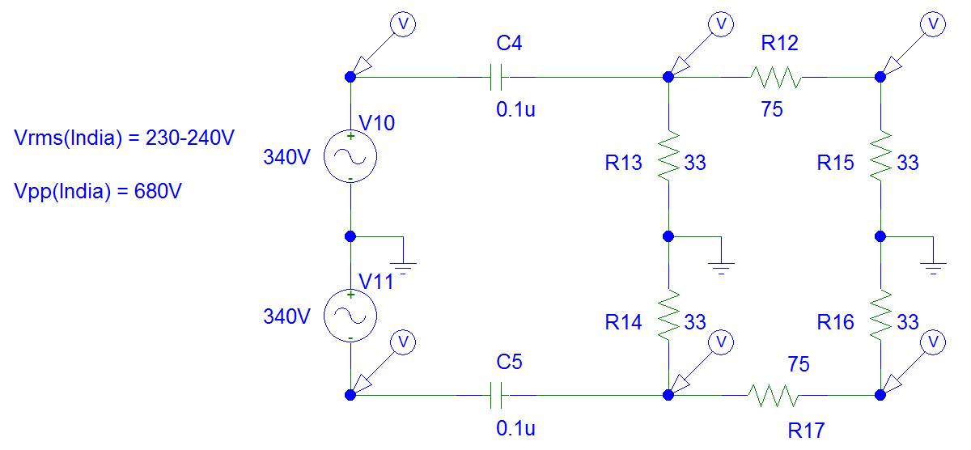
Current Circuit {Vpp = 680V}

Slide 3
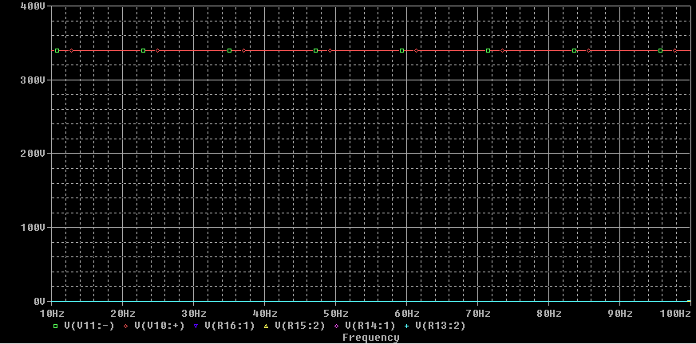
AC Response

Slide 4
Observations
Until 100 Hz output voltage is approx. zero. Voltage across capacitors is 340V exactly Vpeak of input voltage.
Another important thing is to figure out power drop across resistance in pass band.

